Slide 1


A Full Body Blood Flow Simulation for TBI Dosimetry
Cassidy Northway, MSc.
PhD Candidate
University of British Columbia
BC Cancer Centre – Vancouver
Supervised by Dr. Ingrid Spadinger

Slide 2
Motivation
What is the heterogeneity of dose to the circulating blood volume during TBI?
Determine dose deposition in time
Track blood flow through the body
Model various TBI treatments

Slide 3
Motivation
What is the heterogeneity of dose to the circulating blood volume during TBI?
Determine dose deposition in time
Track blood flow through the body
Model various TBI treatments

Slide 4
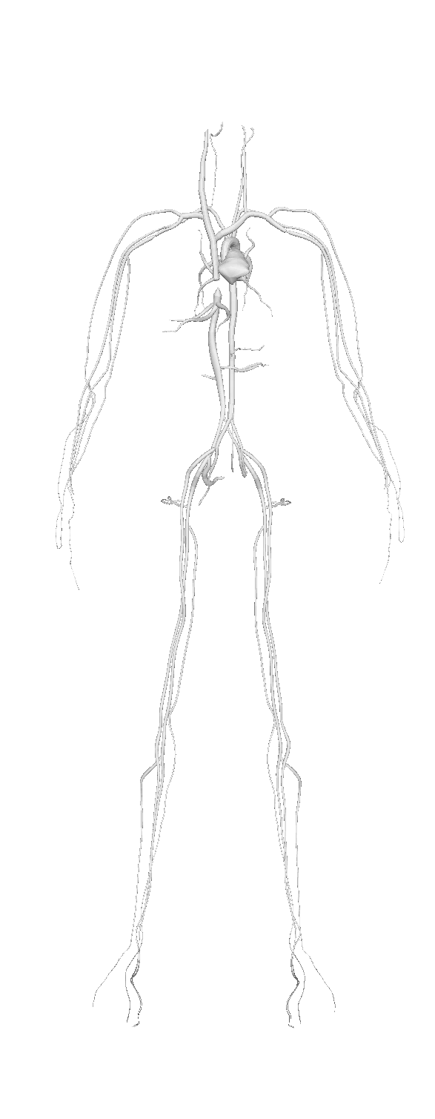
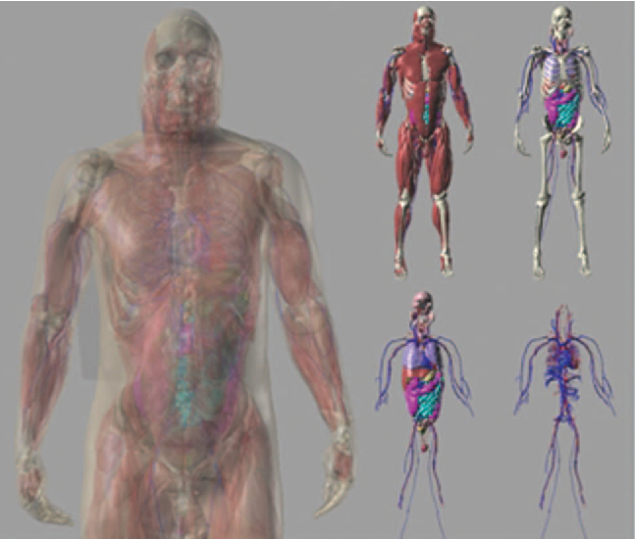
XCAT Phantom
Geometric
n Information
Connectivity nnMap
Segars, W P et al. “4D XCAT phantom for multimodality imaging research.” Medical physics vol. 37, no. 9, 2010.

Slide 5
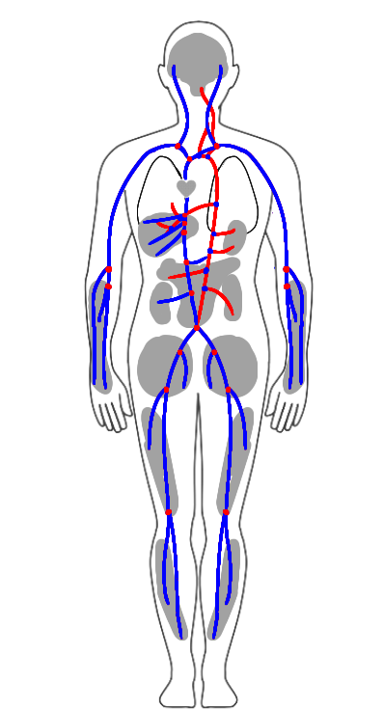
XCAT Phantom
Geometric
n Information
Connectivity nnMap
Segars, W P et al. “4D XCAT phantom for multimodality imaging research.” Medical physics vol. 37, no. 9, 2010.
Notes:
Want to add actual mesh subset image from 3d mesh, also indicate what info we actually extracted from the mesh files for the purposes of the sim

Slide 6
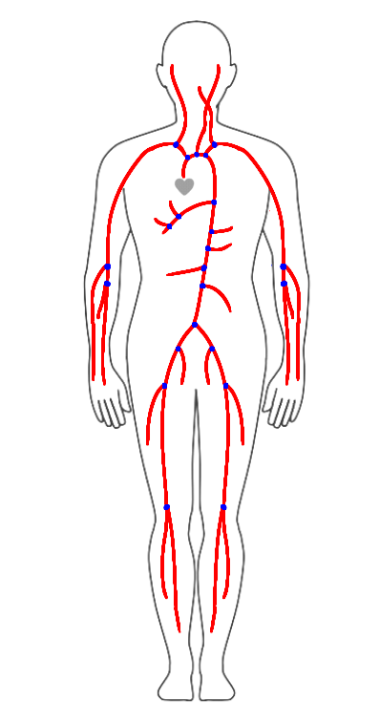
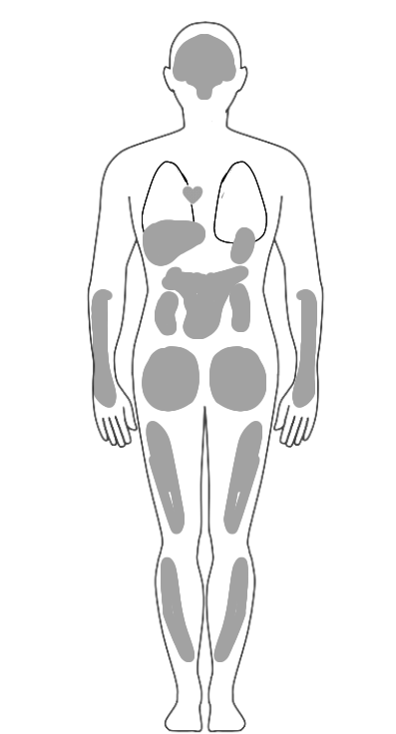
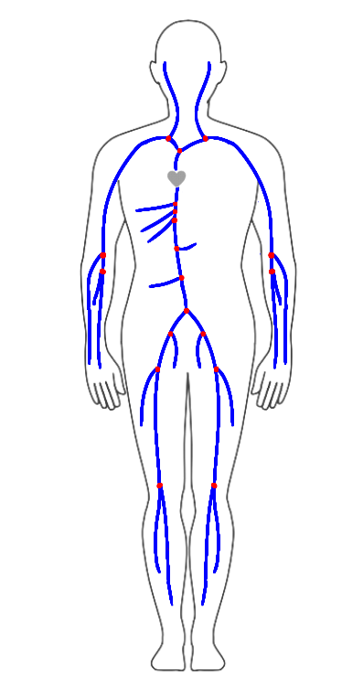
Model Components
=
+
+
Notes:
Create an illustration that contains both arteries and veins with an indication of compartments that is based on the illustrations from the paper. Promise we will go on a BVs journey

Slide 7


Model Components – Systemic Arteries
$$Q \left(x_{i},t\right)$$
Alastruey J, Parker KH, Sherwin SJ. Arterial pulse wave haemodynamics. In Anderson S, editor, 11th International Conference on Pressure Surges. Lisbon: Virtual PiE Led t/a BHR Group. 2012. p. 401-443.
Notes:
1D modelling, what is it, how are vessels connected to each other, how does bv move down the vessels starting at the heart.

Slide 8
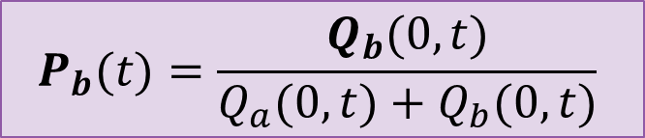
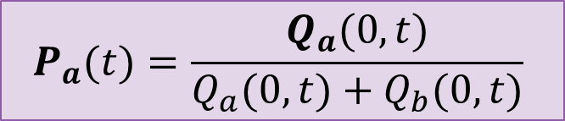
Model Components – Systemic Arteries
$$Q \left(x_{i},t\right)$$
$$P_{a}(t)=\frac{Q_{a}(0,t)}{Q_{a}(0,t)+Q_{b}(0,t)}$$
$$P_{b}(t)=\frac{Q_{b}(0,t)}{Q_{a}(0,t)+Q_{b}(0,t)}$$
Alastruey J, Parker KH, Sherwin SJ. Arterial pulse wave haemodynamics. In Anderson S, editor, 11th International Conference on Pressure Surges. Lisbon: Virtual PiE Led t/a BHR Group. 2012. p. 401-443.

Slide 9
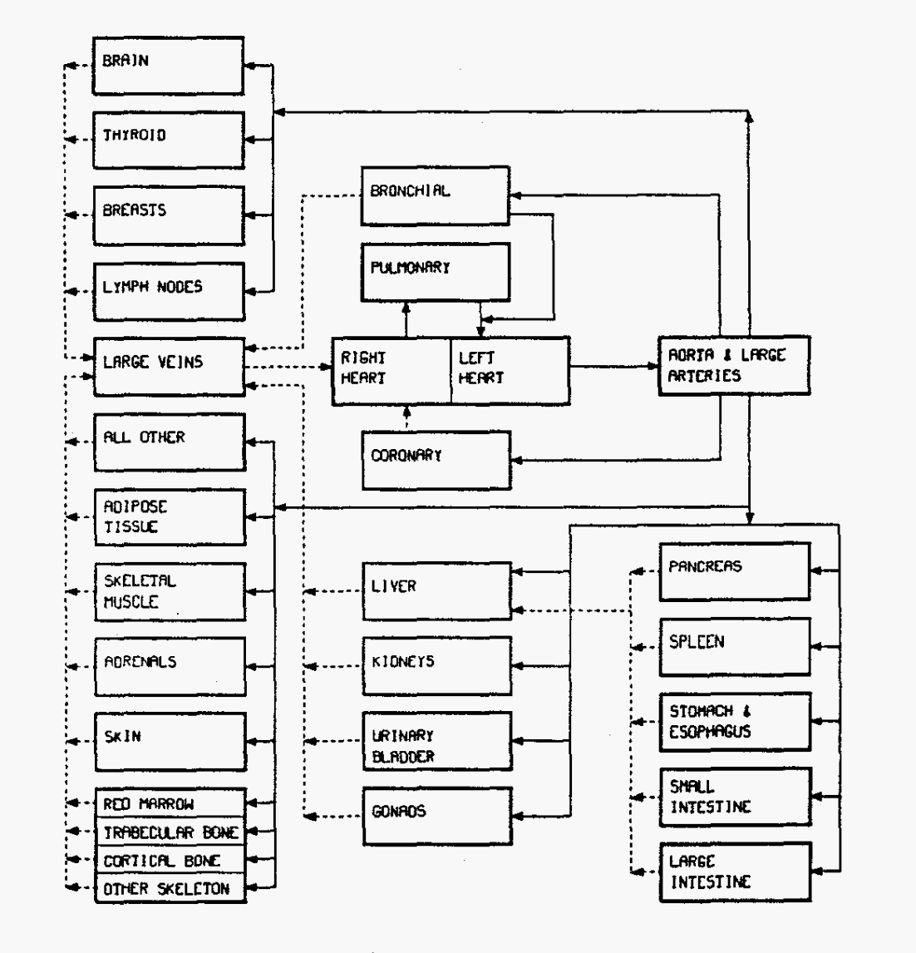
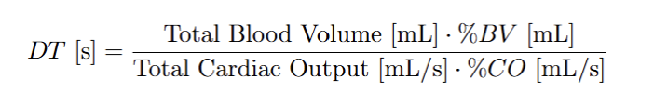
Model Components - Compartments
Dwell Time
Leggett RW, Williams LR. A proposed blood circulation model for Reference Man. Health Phys. 1995 Aug;69(2):187-201.
Notes:
What happens when the BV reaches a compartment,

Slide 10
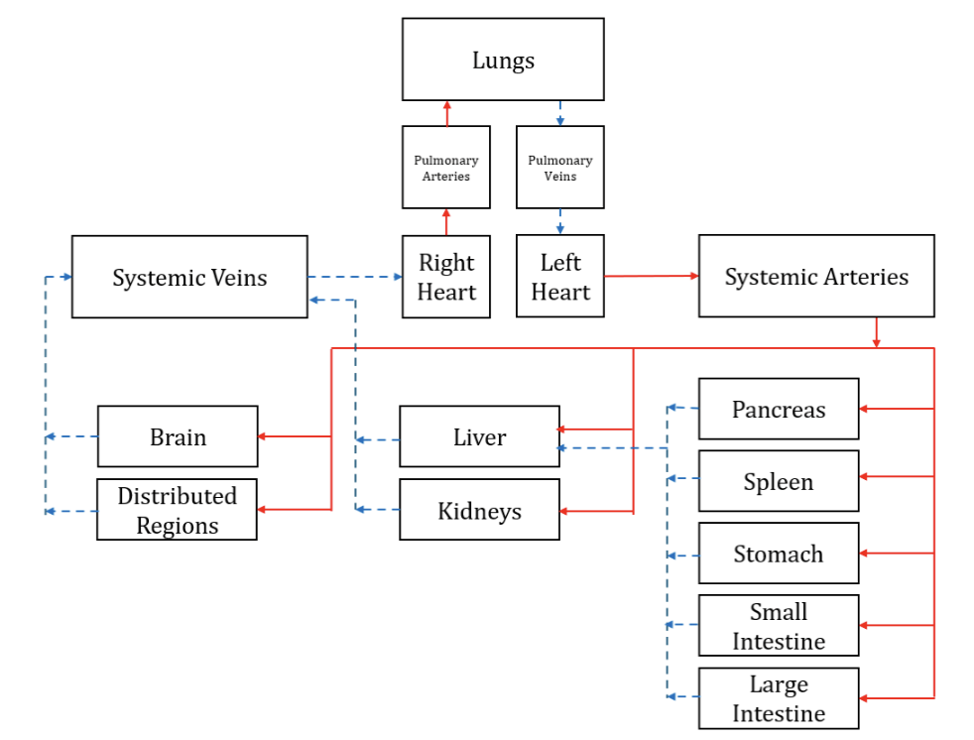
Model Components - Compartments
Dwell Time
Leggett RW, Williams LR. A proposed blood circulation model for Reference Man. Health Phys. 1995 Aug;69(2):187-201.

Slide 11
Model Components - Compartments
Dwell Time
Leggett RW, Williams LR. A proposed blood circulation model for Reference Man. Health Phys. 1995 Aug;69(2):187-201.

Slide 12
Model Components – Systemic Veins
Doppler ultrasound and MRI flowrate data
Notes:
1D modelling, what is it, how are vessels connected to each other, how does bv move down the vessels starting at the heart.

Slide 13
Model Components – Systemic Veins
Doppler ultrasound and MRI flowrate data
Notes:
1D modelling, what is it, how are vessels connected to each other, how does bv move down the vessels starting at the heart.

Slide 14
Model Tuning
Blanco, P.J., Watanabe, S.M., Dari, E.A. et al. Blood flow distribution in an anatomically detailed arterial network model: criteria and algorithms. Biomech Model Mechanobiol 13, 1303–1330 (2014).
Notes:
What we used to determine the initial estimates, how we tuned the values and the resulting BV dist

Slide 15
Model Tuning
Notes:
What we used to determine the initial estimates, how we tuned the values and the resulting BV dist

Slide 16
Model Tuning
Notes:
Heart compressed to one unit as opposed to multiple chambers
Spending great blood pool in veins. Compare avg transit time to test whether this is a sig issue.

Slide 17

Model Tuning – Mean Travel Time
Shin J, Xing S, McCullum L, Hammi A, Pursley J, Correa CA, Withrow J, Domal S, Bolch W, Paganetti H, Grassberger C. HEDOS-a computational tool to assess radiation dose to circulating blood cells during external beam radiotherapy based on whole-body blood flow simulations. Phys Med Biol. 2021 Aug 3;66(16)
Notes:
Heart compressed to one unit as opposed to multiple chambers
Spending great blood pool in veins. Compare avg transit time to test whether this is a sig issue.

Slide 18
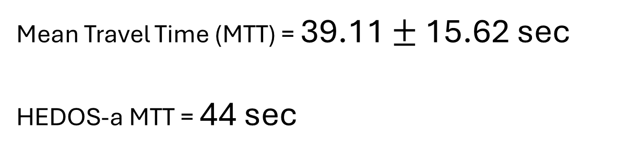
Model Tuning – Mean Travel Time
Mean Travel Time (MTT) = 39.11 $±$15.62 sec
HEDOS-a MTT = 44 sec
Shin J, Xing S, McCullum L, Hammi A, Pursley J, Correa CA, Withrow J, Domal S, Bolch W, Paganetti H, Grassberger C. HEDOS-a computational tool to assess radiation dose to circulating blood cells during external beam radiotherapy based on whole-body blood flow simulations. Phys Med Biol. 2021 Aug 3;66(16)
Notes:
Heart compressed to one unit as opposed to multiple chambers
Spending great blood pool in veins. Compare avg transit time to test whether this is a sig issue.

Slide 19

Future Applications
4D Monte Carlo simulations of:
Co-60 TBI
POP TBI
VMAT TBI
Thank you
Su, S et al. “A new DOSXYZnrc method for Monte Carlo simulations of 4D dose distributions.” Physics in medicine and biology vol. 66, 24 2021.

Slide 20
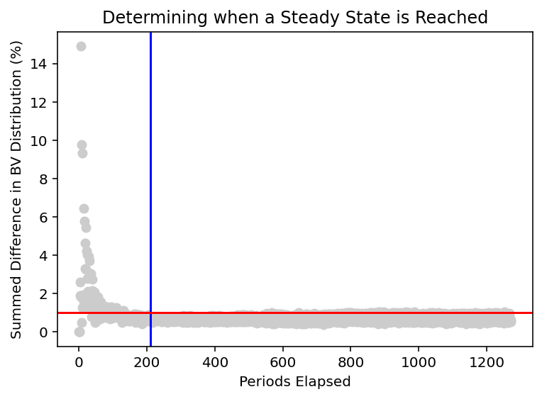

Steady State Identification
All Blood Voxels Released
1%
$$\sqrt{\sum_{i }{{\left({\%BV}_{i}^{o}−{\%BV}_{i}^{n}\right)}^{2}}}$$

Slide 21

Model Components – Systemic Veins
Doppler ultrasound and MRI flowrate data
$$Q\left(0\right)= {Q(L)}_{a}+{Q(L)}_{b}$$
Notes:
1D modelling, what is it, how are vessels connected to each other, how does bv move down the vessels starting at the heart.

Slide 22
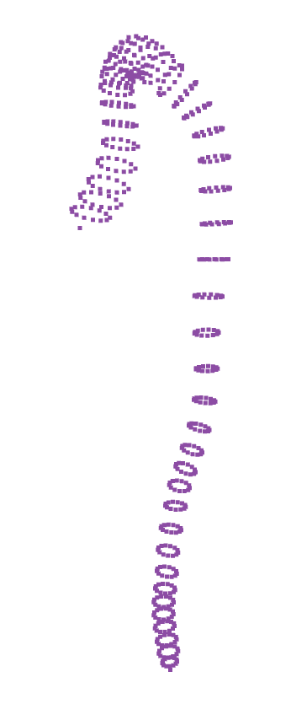
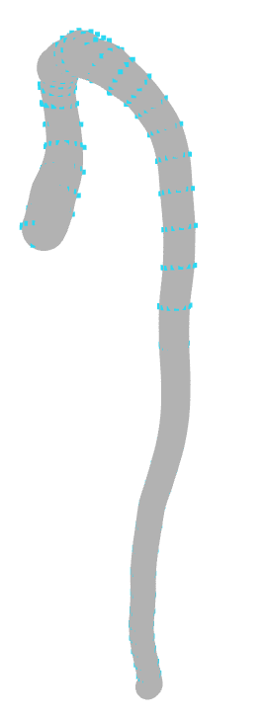
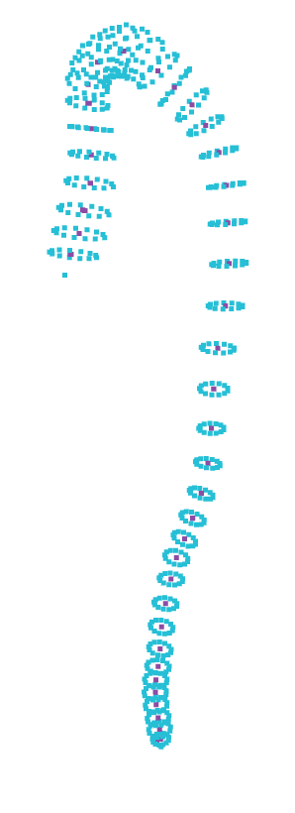
Dimension Extraction
Superior Mesenteric Artery
Calculated length (N =12)
$\overline{L}=220.84 mm ±0.33 \%$
Manually measured length
$L=212.75$ mm
Hemolab Value:
$L=216.79$ mm
Calculated radius (N = 12)
$R_{u}=1.79 mm ±2.79 \%$
$R_{d}=1.66 mm±18.67 \%$
Jin, Young-Hoon, and Won-Hyung Lee. “Fast cylinder shape matching using random sample consensus in large Scale Point Cloud.” Applied Sciences, 9, 5, 2019.
Watanabe, Sansuke M., Blanco, Pablo J., and Feijóo, Raúl A.. "Mathematical Model of Blood Flow in an Anatomically Detailed Arterial Network of the Arm." ESAIM: Mathematical Modelling and Numerical Analysis - Modélisation Mathématique et Analyse Numérique 47, 4, 2013.

Slide 23
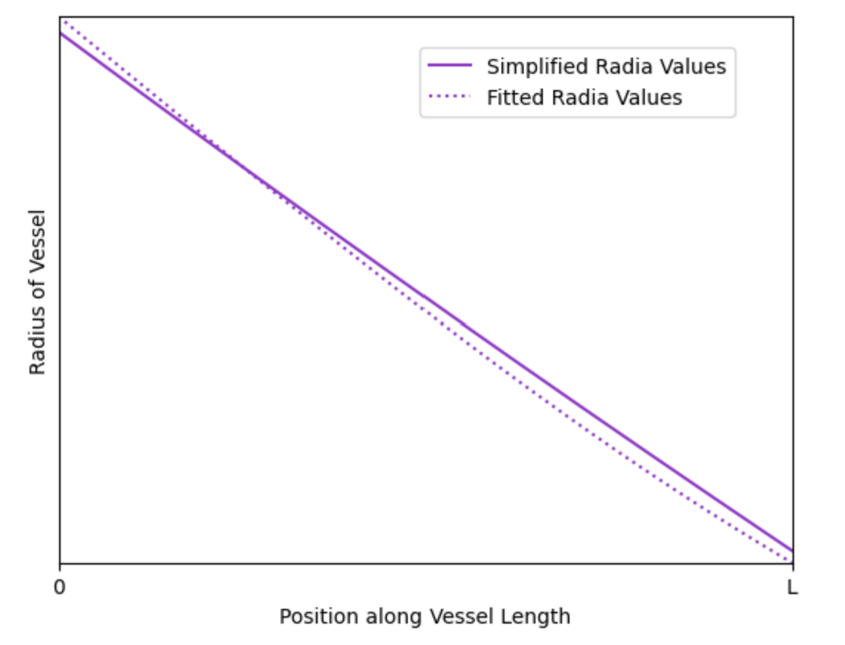
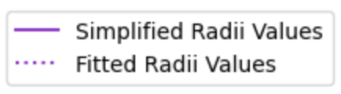
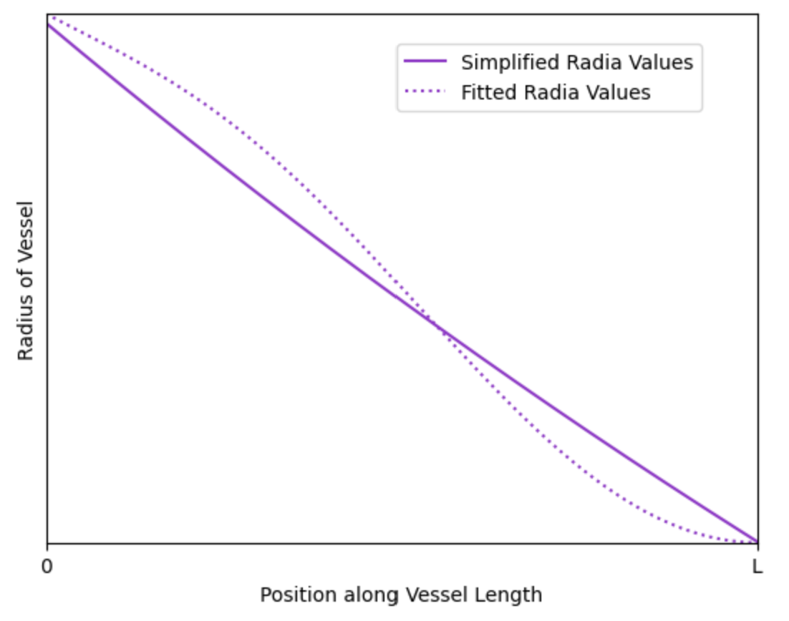
Network and Simplifications
$$R \left(x\right)=R_{u} {\frac{R_{d}}{R_{u}}}^{\frac{x}{L}}$$
Olufsen, Mette Sofie. “Structured tree outflow condition for blood flow in larger systemic arteries.” American journal of physiology. Heart and circulatory physiology , 276, 1, 1999.

